Slide 1



MCSE 666:Pattern and Speech Recognition
Classifier Learning
(K-Nearest Neighbors and Naive Bayes)
Dr. Md. Aminul Haque Akhand Dept. of CSE, SUB

Slide 2
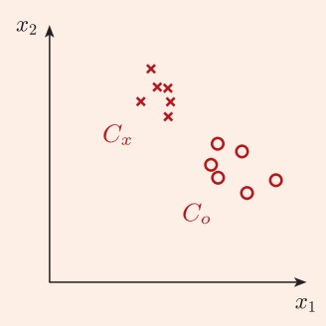
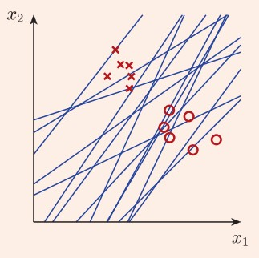
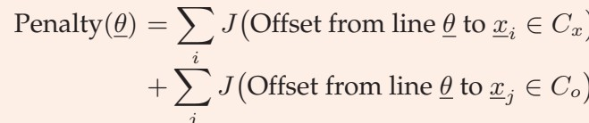
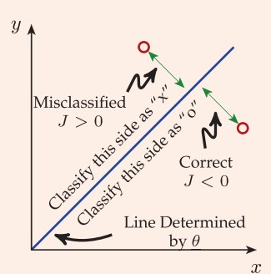
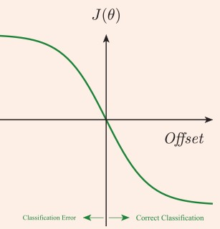
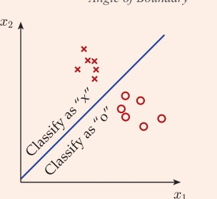
Regression and Classification
2

Slide 3
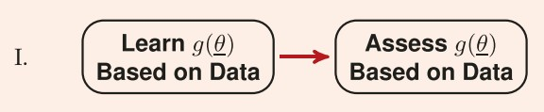
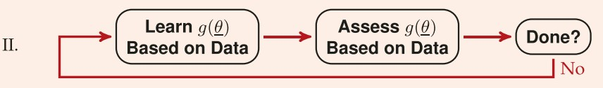
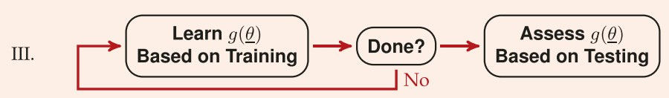
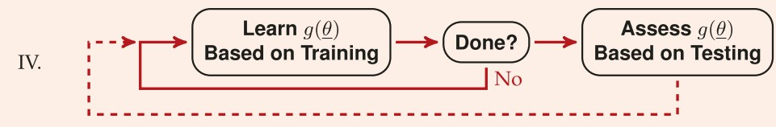
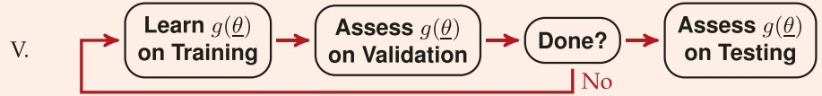
Use of Data in Learning
3

Slide 4
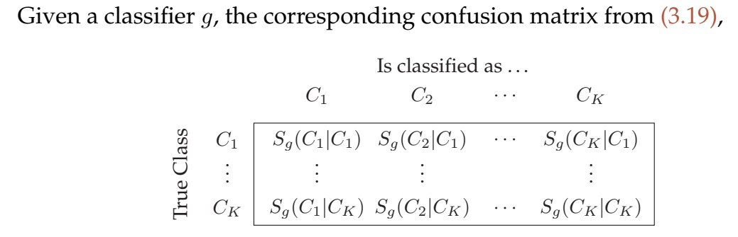
Classifier Evaluation / Performance Measure
4
Test Set Accuracy
Test Set Error Rate
Confusion Matrix

Slide 5
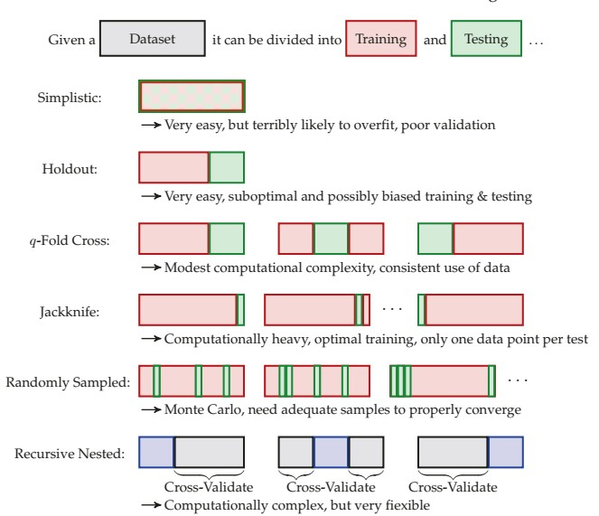
Classifier Validation
5

Slide 6
K-Nearest Neighbor (KNN) Classifier
6

Slide 7
KNN Overview
KNN algorithm is one of the simplest classification algorithm
Non-parametric
It does not make any assumptions on the underlying data distribution
Lazy learning algorithm.
there is no explicit training phase or it is very minimal.
also means that the training phase is pretty fast .
Lack of generalization means that KNN keeps all the training data.
Its purpose is to use a database in which the data points are separated into several classes to predict the classification of a new sample point.

Slide 8
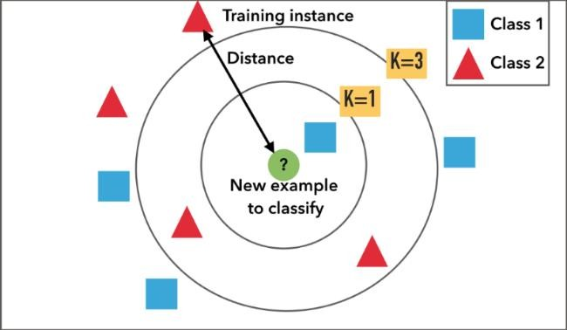
KNN
KNN Algorithm is based on feature similarity
How closely out-of-sample features resemble our training set determines how we classify a given data point

Slide 9









KNN for K = 1 or K = 3
9
k = 1
k = 3
P8
P7
P8
P7
Pn
Pn
P6
P6
P4
P5
P4
P5
P2
P3
P2
P3
P1
P1

Slide 10



1-Nearest Neighbor

Slide 11
3-Nearest Neighbor

Slide 12
Classification Steps
Training phase: a model is constructed from the training
instances.
classification algorithm finds relationships between predictors and targets
relationships are summarised in a model
Testing phase: test the model on a test sample whose class labels are known but not used for training the model
Usage phase: use the model for classification on new data
whose class labels are unknown
https://www.tutorialspoint.com/machine_learning_with_python/machine_learning_with_pyt hon_knn_algorithm_finding_nearest_neighbors.htm

Slide 13
KNN Features
All instances correspond to points in an n-dimensional Euclidean space
Classification is delayed till a new instance arrives
Classification done by comparing feature vectors of the different points
Target function may be discrete or real-valued
It uses the local neighborhood to obtain a prediction
The K memorized examples more similar to the one that is being classified are retrieved

Slide 14
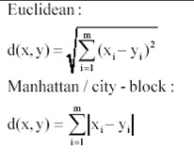
KNN Features
A distance function is needed to compare the examples similarity
This means that if we change the distance function, we change how examples are classified
Learning is very simple but Classification is time consuming

Slide 15
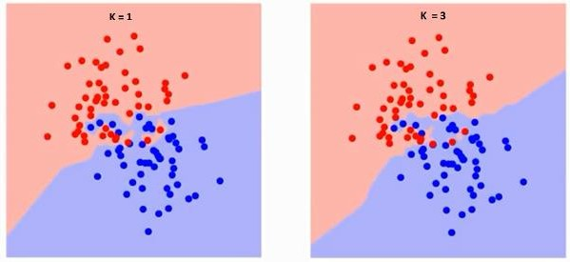
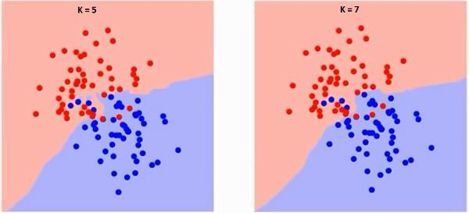
KNN Classifier : Effect of K Value
5
1
The boundary becomes smoother with increasing value of K.
With K increasing to infinity it finally becomes all blue or all red depending on the total majority.
https://www.analyticsvidhya.com/blog/2018/03/introduction-k-neighbours-algorithm- clustering/#h-what-is-knn-k-nearest-neighbor-algorithm

Slide 16
KNN Classifier: Conclusions
16
Pros of KNN
Very simple algorithm to understand and interpret.
Very useful for nonlinear data because there is no assumption about data in KNN.
Versatile algorithm as we can use it for classification as well as regression.
High accuracy but there are much better supervised learning models than KNN.
Cons of KNN
Computationally a bit expensive algorithm because it stores all the training data.
High memory storage required as compared to other supervised learning algorithms.
Prediction is slow in case of big N.
Very sensitive to the scale of data as well as irrelevant features.
Applications of KNN
Banking System: to predict weather an individual is fit for loan approval? Does that individual have the characteristics similar to the defaulters one?
Calculating Credit Ratings: can be used to find an individual’s credit rating by comparing with the persons having similar traits.
Other areas: can be used are Speech Recognition, Handwriting Detection, Image Recognition and Video Recognition.

Slide 17
Naïve Bayes (NB) Classifier
17

Slide 18
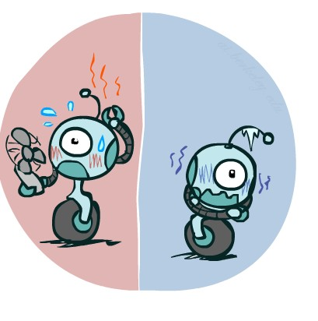

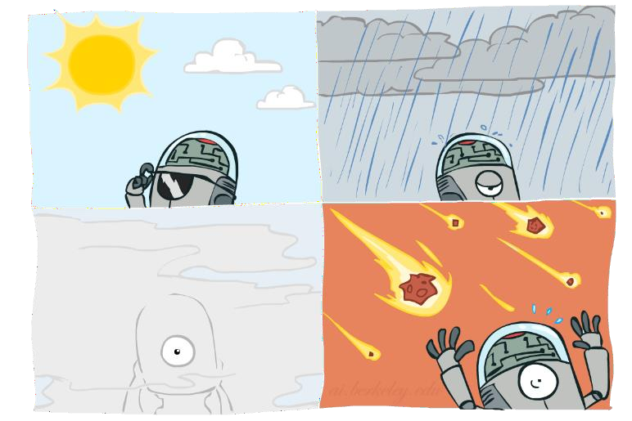

Probability Distributions
18
Associate a probability with each value
Temperature:
Weather:
W | P
sun | 0.6
rain | 0.1
fog | 0.3
meteor | 0.0
T | P
hot | 0.5
cold | 0.5

Slide 19
Probabilistic Models
19
A probabilistic model is a joint distribution over a set of random variables
Probabilistic models:
Distribution over T, W
(Random) variables with domains
Assignments are called outcomes
Joint distributions: say whether assignments
(outcomes) are likely
Normalized: sum to 1.0
Ideally: only certain variables directly interact
T | W | P
hot | sun | 0.4
hot | rain | 0.1
cold | sun | 0.2
cold | rain | 0.3

Slide 20

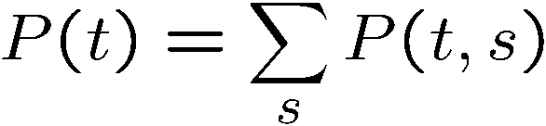
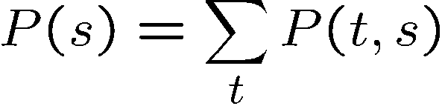
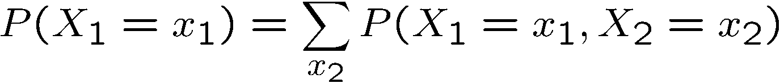
Marginal Distributions
20
Marginal distributions are sub-tables which eliminate variables
Marginalization (summing out): Combine collapsed rows by adding
T | P
hot | 0.5
cold | 0.5
T | W | P
hot | sun | 0.4
hot | rain | 0.1
cold | sun | 0.2
cold | rain | 0.3
W | P
sun | 0.6
rain | 0.4

Slide 21
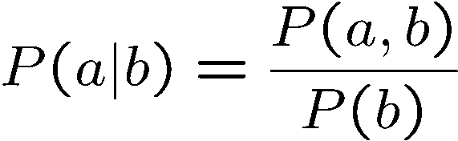
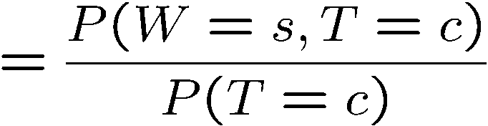
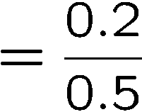



Conditional Probabilities
21
A simple relation between joint and conditional probabilities
In fact, this is taken as the definition of a conditional probability
P(a,b)
P(a)
P(b)
T | W | P
hot | sun | 0.4
hot | rain | 0.1
cold | sun | 0.2
cold | rain | 0.3

Slide 22
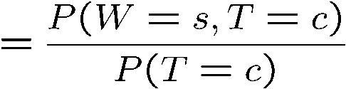

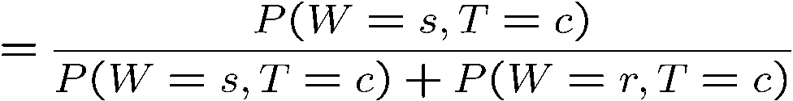
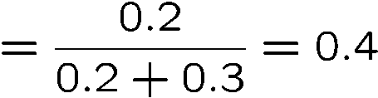

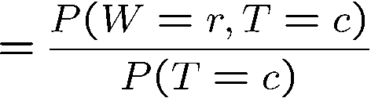

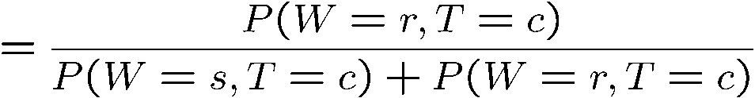
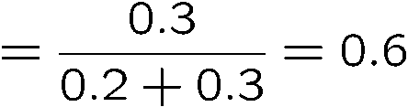
Normalization Trick
22
T | W | P
hot | sun | 0.4
hot | rain | 0.1
cold | sun | 0.2
cold | rain | 0.3
W | P
sun | 0.4
rain | 0.6

Slide 23
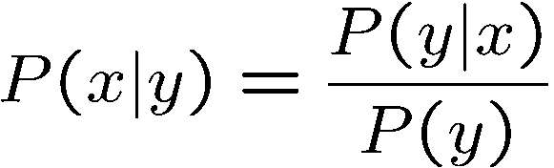





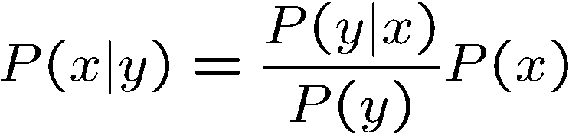
Bayes’ Rule
23
P(x,y)
P(x)
P(y)

Slide 24



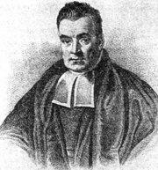
Bayes’ Rule
24
HP
2023-10-04 11:26:32
--------------------------------------------
https://docs.google.com/document/d/1mMflnvla-s_ZvzOU9R3S4B7tAJYe6L8UfY90O_CQiMA/edit?usp=sharing
Prior, conditional and joint probability
Prior probability:P(X)
Conditional probability: P(X₁ |X₂ ), P(X₂ |X₁)
Joint probability: X = (X₁ ,X₂ ), P(X) = P(X₁ ,X₂ )
Relationship: P(X₁ ,X₂ ) = P(X₂ |X₁)P(X₁) = P(X₁ |X₂ )P(X₂ )
– Independence: P(X₂ |X₁) = P(X₂ ), P(X₁ |X₂ ) = P(X₁), P(X₁ ,X₂ ) = P(X₁)P(X₂ )
Bayesian Rule
P(X|C)P(C) P(X)
Likelihood× Prior Evidence
P(C|X) =
Posterior =

Slide 25
Naïve Bayes (NB) Classifier
25
Establishing a probabilistic model for classification
– Discriminative model
P(C|X) C = c₁ ,⋅⋅⋅,c_{L} , X = (X₁ ,⋅⋅⋅,X_{n} )
MAP classification rule
MAP: Maximum A Posterior
Assign x to c* if
P(C = c* |X = x) > P(C = c|X = x)
*
c ≠ c , c = c ,
⋅⋅⋅,c
1
L

Slide 26
Naïve Bayes (NB) Classifier
26
Naïve Bayes Algorithm (for discrete input attributes)
– Learning Phase: Given a training set S,
For each target value of c_{i} (c_{i} = c₁ ,⋅ ⋅ ⋅,c_{L} )
P^{ˆ}(C = c_{i} ) ← estimate P(C = c_{i} ) with examples in S;
For every attributevalue a_{jk} of each attribute x_{j} ( j = 1,⋅ ⋅ ⋅,n; k = 1,⋅ ⋅ ⋅,N_{j} )
P^{ˆ}(X_{j} = a_{jk} |C = c_{i} ) ← estimate P(X_{j} = a_{jk} |C = c_{i} ) with examples in S;
Output: conditional probability tables; for x_{j ,} N_{j} × L elements
– Test Phase: Given an unknown instance X′ = (a₁′ ,⋅⋅⋅,a_{n}′ ),
Look up tables to assign the label c* to X’ if
ˆ ˆ
* *
ˆ ˆ
ˆ ˆ
′ ′
*
′ ′
*
[P(a |c ) ⋅⋅⋅ P(a |c )]P(c ) >[P(a |c) ⋅⋅⋅ P(a |c)]P(c),
c ≠ c , c = c ,
⋅⋅⋅,c
1
n
1
n
1
L

Slide 27
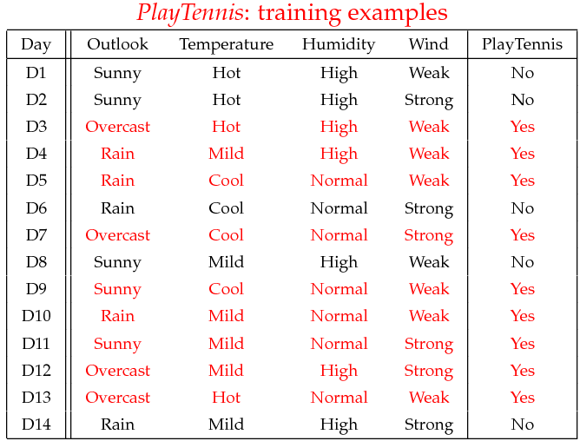
Play Tennis: Classification with NB
27

Slide 28
NB: Learning Phase
28
P(Outlook=o|Play=b)
P(Temperature=t|Play=b)
Outlook | Play=Yes | Play=No
Sunny | 2/9 | 3/5
Overcast | 4/9 | 0/5
Rain | 3/9 | 2/5
Temperature | Play=Yes | Play=No
Hot | 2/9 | 2/5
Mild | 4/9 | 2/5
Cool | 3/9 | 1/5
P(Humidity=h|Play=b)
P(Wind=w|Play=b)
Humidity | Play=Yes | Play=No
High | 3/9 | 4/5
Normal | 6/9 | 1/5
Wind | Play=Yes | Play=No
Strong | 3/9 | 3/5
Weak | 6/9 | 2/5
P(Play=Yes) = 9/14
P(Play=No) = 5/14

Slide 29
NB: Test Phase
29
Given a new instance,
x’=(Outlook=Sunny, Temperature=Cool, Humidity=High, Wind=Strong)
Look up tables
P(Outlook=Sunny|Play=No) = 3/5 P(Temperature=Cool|Play==No) = 1/5 P(Huminity=High|Play=No) = 4/5 P(Wind=Strong|Play=No) = 3/5 P(Play=No) = 5/14
P(Outlook=Sunny|Play=Yes) = 2/9 P(Temperature=Cool|Play=Yes) = 3/9 P(Huminity=High|Play=Yes) = 3/9 P(Wind=Strong|Play=Yes) = 3/9 P(Play=Yes) = 9/14
– MAP rule
P(Yes|x’): [P(Sunny|Yes)P(Cool|Yes)P(High|Yes)P(Strong|Yes)]P(Play=Yes) = 0.0053 P(No|x’): [P(Sunny|No) P(Cool|No)P(High|No)P(Strong|No)]P(Play=No) = 0.0206
Given the fact P(Yes|x’) < P(No|x’), we label x’ to be “No”.

Slide 30
NB for Continuous-values Input Attributes
30
Numberless values for an attribute
Conditional probability modeled with the normal distribution
1
⎛
(X −μ )² ⎞
P^{ˆ}(X_{j} |C = c_{i} ) =
_{exp⎜ −} j ji ⎟
2πσ
⎜
2σ
2
ji
⎟
ji
⎝ ⎠
μ_{ji} : mean (avearage) of attribute values X_{j} of examples for which C = c_{i}
σ _{ji} : standarddeviation of attribute values X _{j} of examples for which C = c_{i}
Learning Phase: for X = (X₁ ,⋅⋅⋅,X_{n} ), C = c₁ ,⋅⋅⋅,c_{L}
Output: n× L normal distributions and P(C = c_{i} ) i = 1,⋅⋅⋅, L
– Test Phase: for X′ = (X′₁ ,⋅⋅⋅,X′_{n} )
–
Calculate conditional probabilities with all the normal distributions
Apply the MAP rule to make a decision

Slide 31
NB Remarks
31
Naïve Bayes based on the independence assumption
Training is very easy and fast; just requiring considering each attribute in each class separately
Test is straightforward; just looking up tables or calculating conditional probabilities with normal distributions

Slide 32
NB Classifier Online Resource
32
Naive Bayes Classifiers
https://www.geeksforgeeks.org/naive-bayes-classifiers/
Naive Bayes Classifier (Explained in Bangla) || Algorithm in Data Mining
|| Data Mining Tutorial
https://www.youtube.com/watch?v=cxWPanlW-L0
Solved Example Naive Bayes Classifier to classify New Instance
PlayTennis Example Mahesh Huddar
https://www.youtube.com/watch?v=XzSlEA4ck2I&list=WL

Slide 33
Lazy & Eager Learning
33
Two Types of Learning Methodologies
Lazy Learning
Instance-based learning. (k-NN)
Eager Learning
Decision-tree and Bayesian classification.
ANN & SVM
P8
P7
P8 P6 |  |  | P7 | Pn
P2 | P3 | P4 | P1 | P5
Pn
P6
P4
P5
P2
P3
P1

Slide 34
Lazy & Eager Learning : Key Differences
34
Lazy Learning
Do not require model building
Less time training but more time predicting
Lazy method effectively uses a richer hypothesis space since it uses many local linear functions to form its implicit global approximation to the target function
Eager Learning
Require model building
More time training but less time predicting
must commit to a single hypothesis that covers the entire instance space

Slide 35
Thanks for your attention
35
HP
2023-10-04 11:25:42
--------------------------------------------
https://docs.google.com/document/d/1mMflnvla-s_ZvzOU9R3S4B7tAJYe6L8UfY90O_CQiMA/edit?usp=sharing
Question and Answer

